Slide 1


Data Science
With AI Core

Slide 2
In the last chapter…
We looked at Machine Learning.
We had access to data which contains some patterns
We created an ML algorithm which modelled the patterns
Given some new input, the model made a prediction
However, Machine Learning is not Data Science. It is just one component within the Data Science pipeline.

Slide 3
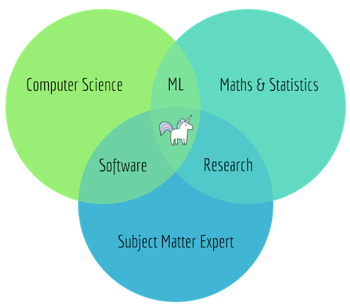
What is Data Science?
Data Science is a multi-disciplinary field between Computer Science, Mathematics and Domain Expertise.
With these skills, we can:
Engineer features
Visualise data
Make predictions
All to the end of communicating key and vital information that help drive business innovation and efficiency.

Slide 4
What can You Do with Data Science?
Anomaly detection (fraud, disease, crime, etc.)
Automation and decision-making (background checks, credit worthiness, etc.)
Classifications (in an email server, this could mean classifying emails as “important” or “junk”)
Forecasting (sales, revenue and customer retention)
Pattern detection (weather patterns, financial market patterns, etc.)
Recognition (facial, voice, text, etc.)
Recommendations (based on learned preferences, recommendation engines can refer you to movies, restaurants and books you may like)

Slide 5
The Data Science Pipeline
Problem Definition
Data Collection
Data Preparation
Model Building
Model Evaluation
Insights and Deployment

Slide 6
Problem Definition
Problem Definition
Data Collection
Data Preparation
Model Building
Model Evaluation
Insights and Deployment
We need to define the problem we are trying to solve
An in-depth understanding of the task at hand
A way to measure solutions
Determine a hypothesis
A hypothesis allows us to lay out our objectives to validate our final results against

Slide 7
Data Collection
Problem Definition
Data Collection
Data Preparation
Model Building
Model Evaluation
Insights and Deployment
We need to gather information which facilitates the solving of our problem.
Depending on the problem, there are a variety of different methods we can use to find and source our data.

Slide 8
Data Preparation
Problem Definition
Data Collection
Data Preparation
Model Building
Model Evaluation
Insights and Deployment
Data we collect is usually raw and unstructured
Missing values, duplicates, un-normalised etc…
Using exploratory data analysis (EDA) to analyse and visualise our data
Allows us to engineer the features we think will be most impactful to a model
Data preparation is all about transforming and preparing our data for use further down the line
Also involves splitting data into train/validation/test sets

Slide 9
Model Building
Problem Definition
Data Collection
Data Preparation
Model Building
Model Evaluation
Insights and Deployment
Using the data we have prepared, we need to build a model
Involves identifying the best type of model for the problem
This is where the machine learning aspect we’ve focused on so far during the course comes into play
This is a cyclical process with model evaluation
Assess the model against our split datasets
We should test multiple variants, and pick the one which maximises evaluation

Slide 10
Insights & Deployment
Problem Definition
Data Collection
Data Preparation
Model Building
Model Evaluation
Insights and Deployment
In order to allow inference to be made against our model, we need to deploy it
In many cases, you may also need to find yourself presenting findings from your model/of your results
Visualisations, recommendations, actionable decisions etc.

Slide 11
In this Chapter
We will cover all the steps of the Data Science pipeline
We will work with multiple different datasets to expose you to different kinds of challenges and problems

